Slide 1
100MW/100MWh BESS
Opportunity Evaluation

Slide 2
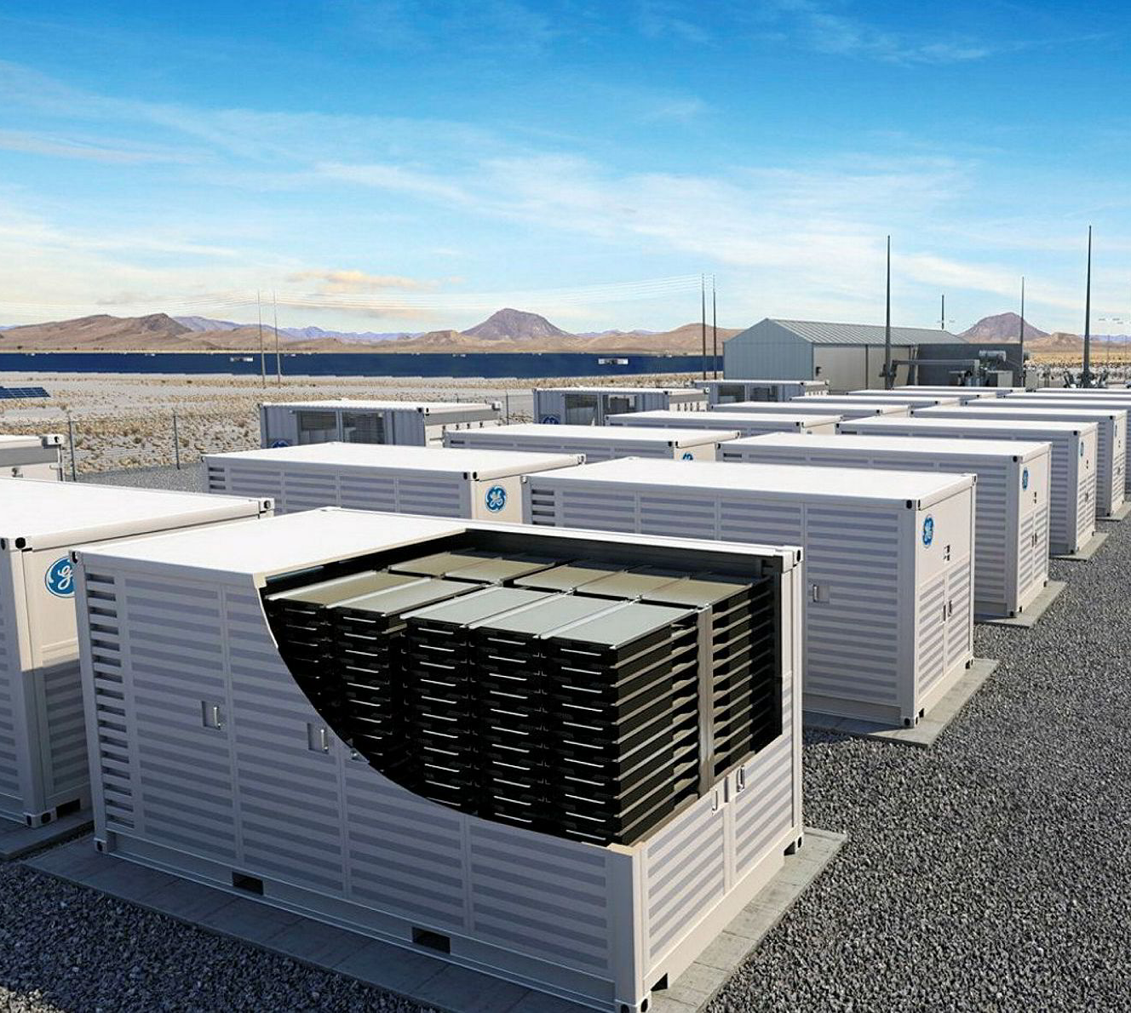
Opportunity Outline
Assumptions
100MW/100MWh Battery Energy Storage System
Round-trip efficiency of 85%
The average daily cycles (full charge and discharge) in each year are equal to 1
Day-ahead market trading
Questions to be answered
Is buying 100 MWh of energy at the hour with the lowest price and selling 100 MWh of energy at the hour with the highest price an effective strategy? Is there a better alternative?
How does the average daily cycles affect battery revenues?

Slide 3
“The Bosses” Arbitrage Trading Strategy

Slide 4
Optimised Trading Strategy

Slide 5
Key Findings

Slide 6
Recommendations & Next Steps
Essential to analyse the impact of this trading strategy on battery degradation and thermal constraints.
Carry out a cost-benefit analysis of a longer duration battery – these are better suited to trading on the wholesale market. However, the longer the duration, the more expensive the battery.
Stack other revenue streams alongside arbitrage (e.g. ancillary services).
Produce/obtain higher quality day-ahead/intra-day power price forecasts. Trading returns are dependent on the quality of forecasts.
Determine the warranty conditions of the battery. Leniency on daily cycles for days with large price spreads will be advantageous.

